Slide 1


Comparison of Dijkstra and A* Pathfinding Algorithms
21K-3153
21K-3372
21K-4529

Slide 2
Problem Statement and Overview
Problem Statement:
Does the A* algorithm, which is an optimized version of Dijkstra’s pathfinding algorithm, perform better than Dijkstra in real life implementations?
Overview:
The user will be able to make their own graphs by plotting points and drawing edges.
They will choose their beginning and end node, and compare the time taken by both Dijkstra and A* algorithms.

Slide 3
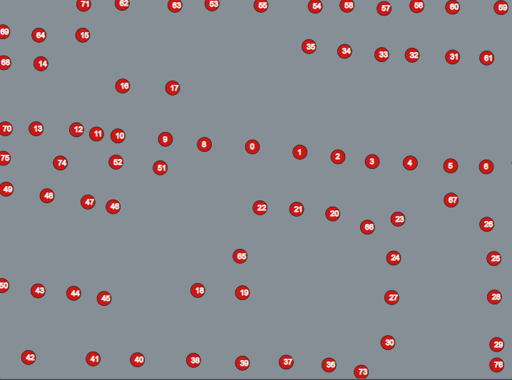
How it works: Plot Points

Slide 4
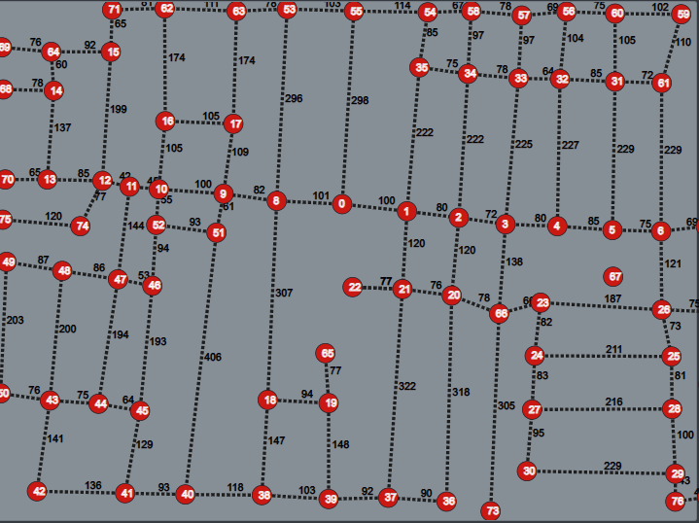
Make paths

Slide 5


Choose starting and ending node
Choose which algorithm to run
Observe results

Slide 6
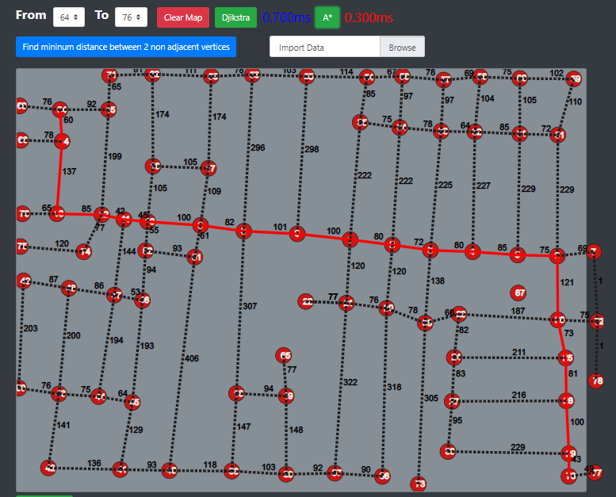

Slide 7
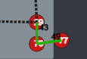
Bonus: Find the shortest path between the 2 closest non-adjacent vertices

Slide 8
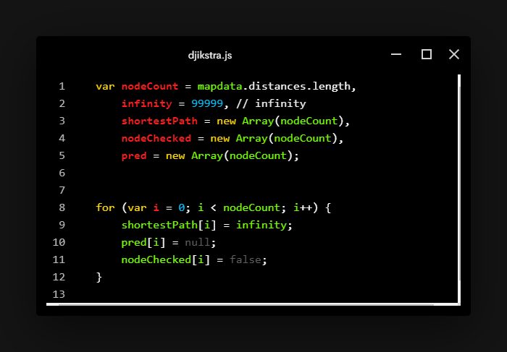
Methodology: Dijkstra

Slide 9
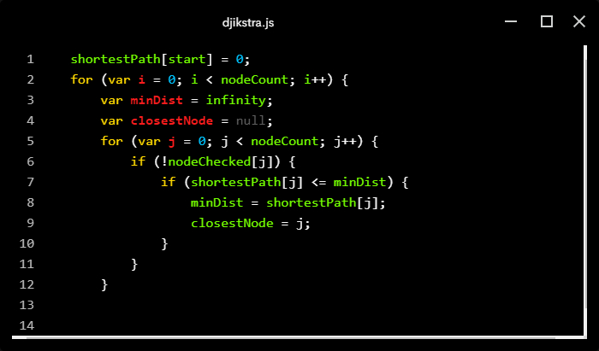
This loop finds the closest unchecked node to the start node based on the current known shortest paths.

Slide 10
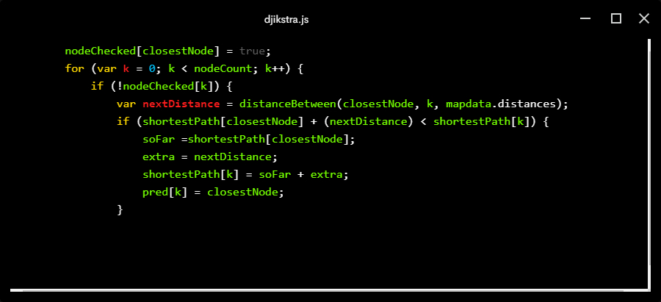
This loop updates the shortest paths for the nodes that are not checked. If a shorter path is found from the start node to a node through the current closest node, update the shortest path and set the predecessor.

Slide 11
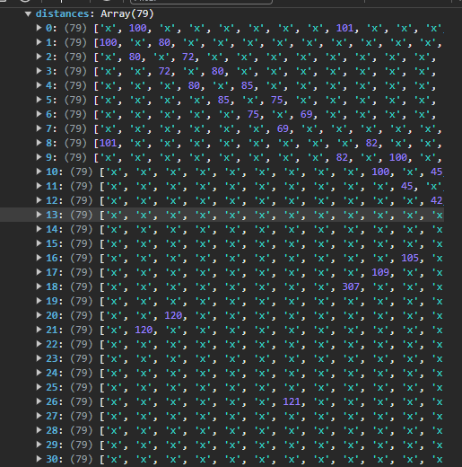
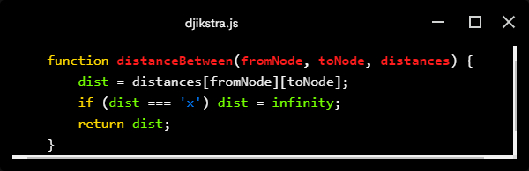
Calculations done on the basis of an adjacency matrix and the function above

Slide 12
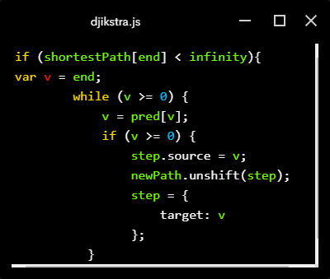
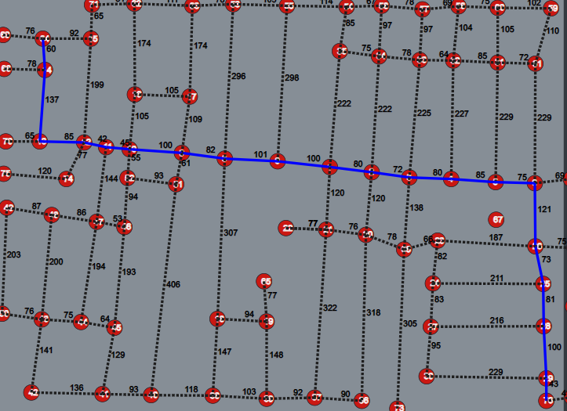
The path is drawn by backtracking through the predecessor array

Slide 13
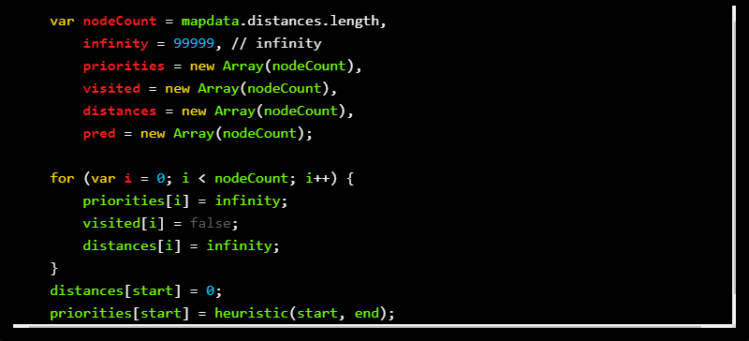
Methodology: A*

Slide 14
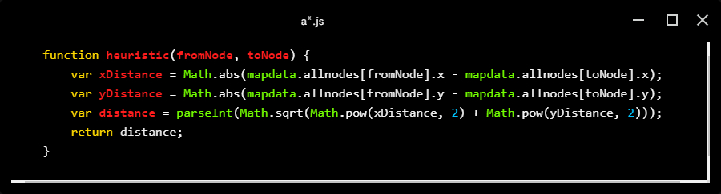
Our heuristic Euclidean distance function

Slide 15
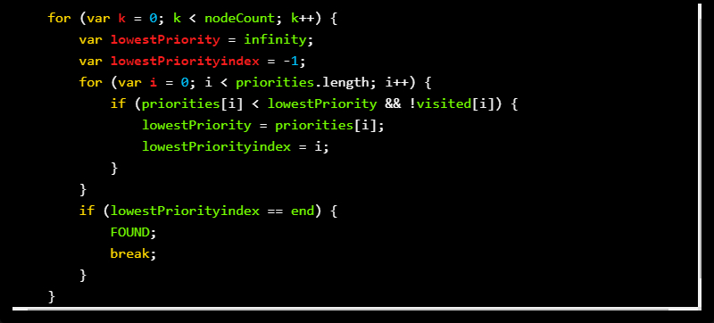
The algorithm selects the node with the lowest priority among unvisited nodes (lowestPriorityindex) using the inner loop.

Slide 16
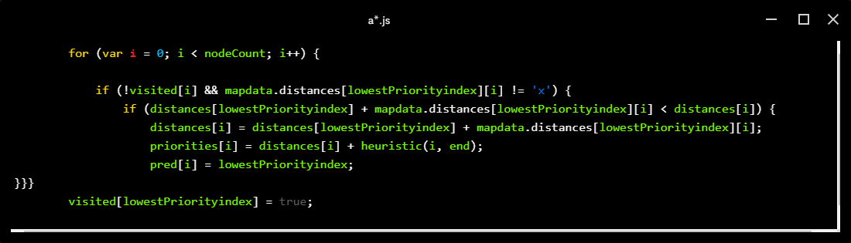
The loop updates the distances and priorities of neighboring nodes based on the current node (lowestPriorityindex)
If a neighboring node is unvisited and has a valid connection (mapdata.distances[lowestPriorityindex][i] != 'x'), it calculates a potential shorter distance.
If the newly calculated distance is shorter, it updates the distance, priority, and predecessor of that node.
The priority is calculated as the sum of the actual distance to that node (distances[i]) and the heuristic estimate to the goal (heuristic(i, end)).

Slide 17
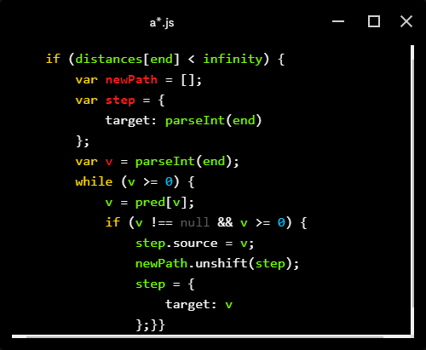
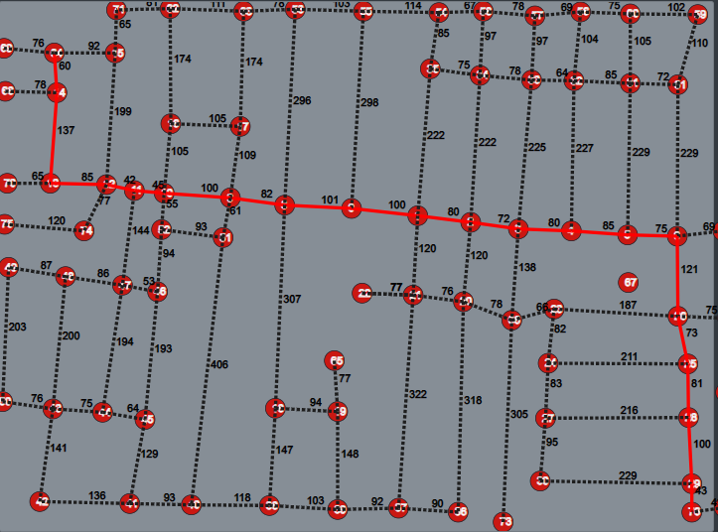
The path is drawn by backtracking through the predecessor array

Slide 18
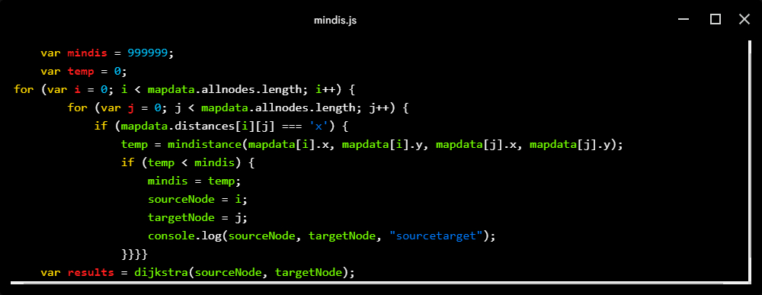
Methodology: Distance b/w closest nodes
We traverse all the nodes to find two non-adjacent nodes (represented by ‘x’) and calculate their shortest path between them.

Slide 19
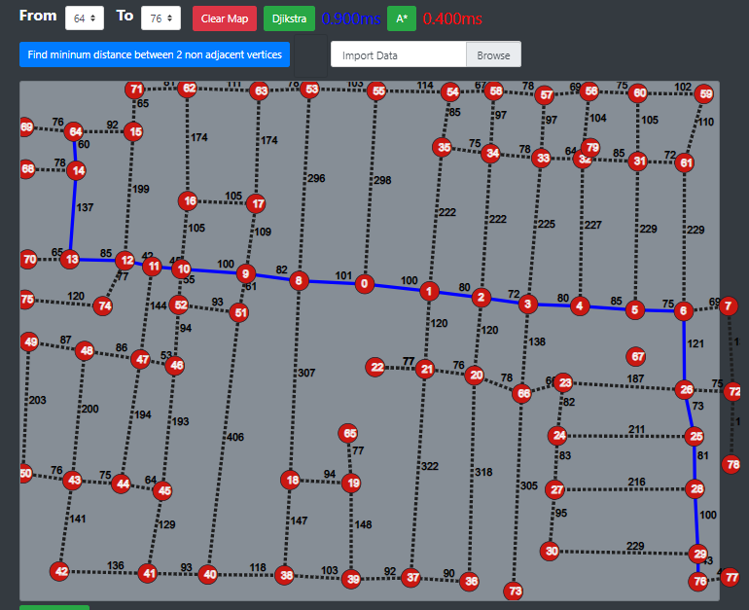
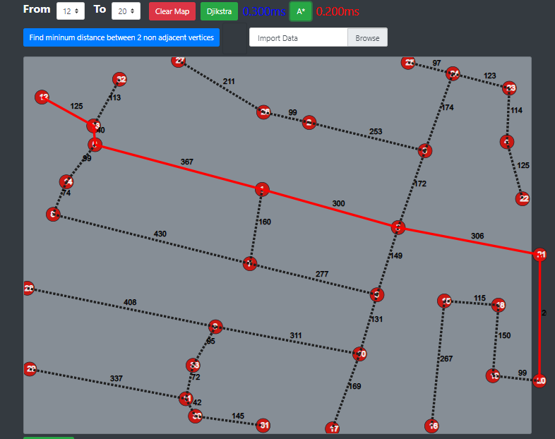
Conclusions

Slide 20
Conclusions
As shown in the previous slide, on graphs with many nodes and edges, the A* algorithm is always faster than Dijkstra’s.
A*’s heuristic approach to find the most optimal nodes to conduct computations from make it faster than Dijkstra.
Since Dijkstra does not have a heuristic function, it is forced to visit all nodes. This lengthens execution time on larger graphs.
However, there is one drawback

Slide 21
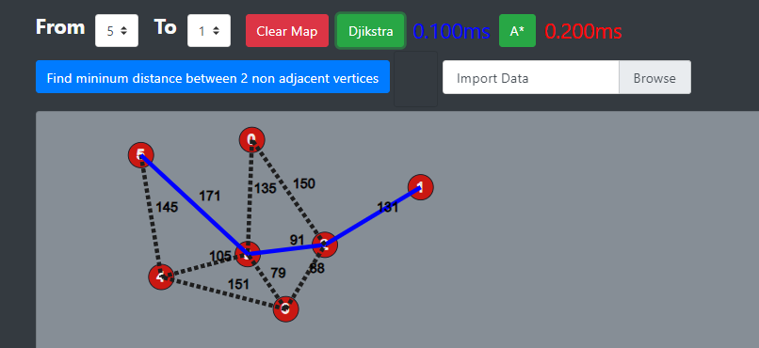
On shorter graphs, Dijsktra can be faster than A*, as the overhead from the heuristic function causes the A* algorithm to take longer.

Slide 22
Conclusion
In summary, the A* algorithm is a much better choice than Dijkstra for pathfinding due to it’s heuristic function and intelligent selection of future nodes.
Thank You!

